Slide 1

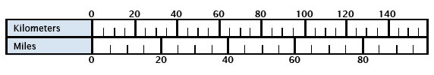
Are we all measuring in miles or kilometers? Building trust in metrics though standards
Todd Carpenter
Executive Director, NISO
September 26, 2014
Notes:
Quoting Betsy Wilson this morning: Effective, sustainable and meaningful library assessment.

Slide 2

About
Non-profit industry trade association accredited by ANSI
Mission of developing and maintaining technical standards related to information, documentation, discovery and distribution of published materials and media
Volunteer driven organization: 400+ contributors spread out across the world
Responsible (directly and indirectly) for standards like ISSN, DOI, Dublin Core metadata, DAISY digital talking books, OpenURL, MARC records, and ISBN

Slide 3

How fast are we going?

Slide 4

Pound-foot/seconds or kilogram-meter/seconds
Notes:
This is the Mars Climate Orbiter that was launched in 1998 and arrived at Mars in 1999. Unfortunately, it didn’t survive it’s encounter. Instead of thrusting into a nice comfortable 160-KM orbit about the plant, it descended to 57 km where it promptly burned up in the atmosphere.

Slide 5
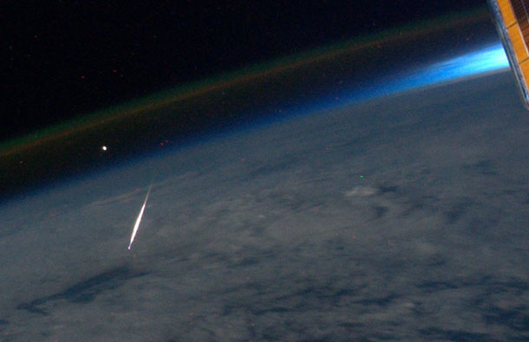
No researcher wants this to be the end of their career?
Notes:
This is the

Slide 6
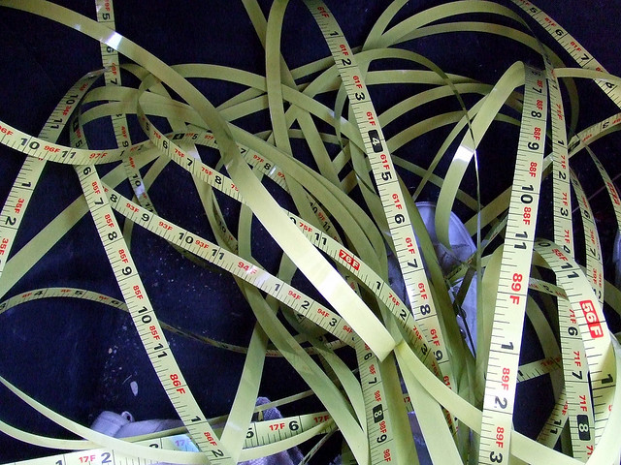
Are we measuring scholarship using “English” or “Metrics”
Image: Flickr user karindalziel
Notes:
This is the

Slide 8
What are the infrastructure elements of alternative assessments?

Slide 9
Basic Definitions (So we are all talking about the same thing) Altmetrics, impact, article-level metrics, social media metrics, usage

Slide 10


Element Identification

Slide 11
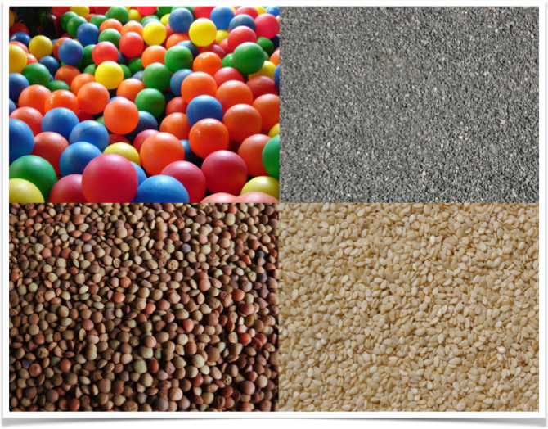
At what granularity?

Slide 12
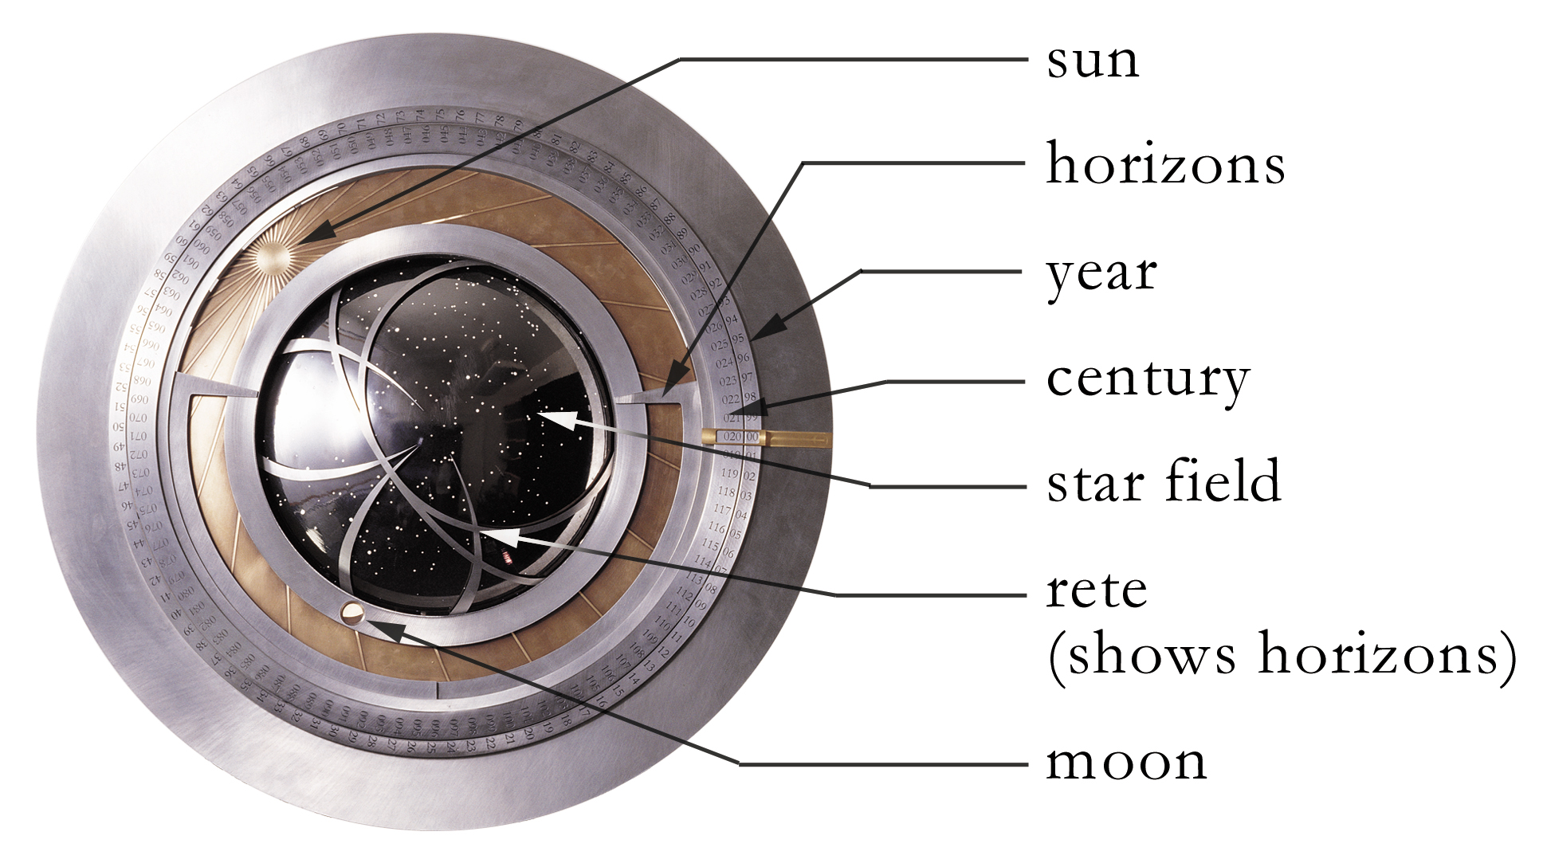
How long do we measure?

Slide 13


Slide 14
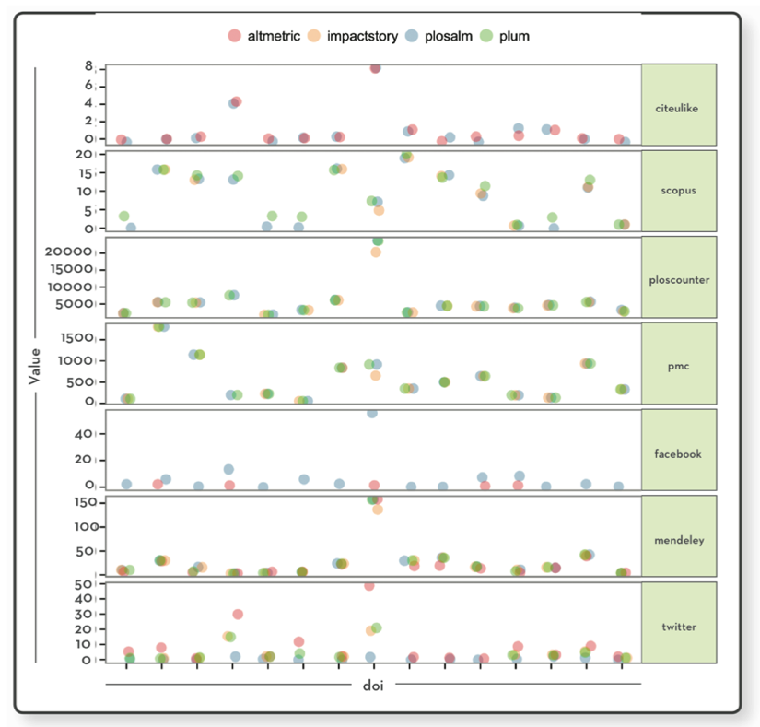
Consistency across providers
Source: Scott Chamberlain, Consuming Article-Level Metrics:
Observations And Lessons From Comparing Aggregator Provider Data, Information Standards Quarterly, Summer 2013, Vol 25, Issue 2.
Notes:
This is data from Scott Chamberlain published in the Summer issue of NISO’s magazine, Information Standards Quarterly (ISQ). In that article, Scott compared the data from four different altmetric service provider providers on a set of different papers. He found that on 6 different data elements, most of the data was inconsistent. If we are going to be basing any decisions on data sources, there has to be clarity of what is counted, how it is gathered, what is extracted, etc.

Slide 15
I often sound like a broken record
Defining what is to count = standards
How to describe what to count = standards
Identification of what to count = standards
Aggregating counts from network = standards
Exchange of what was counted = standards
Procedures for counting or not = standards

Slide 16

TRUST
=

Slide 17



Slide 18


Slide 19
Steering Committee
Euan Adie, Altmetric
Amy Brand, Harvard University
Mike Buschman, Plum Analytics
Todd Carpenter, NISO
Martin Fenner, Public Library of Science (PLoS) (Chair)
Michael Habib, Reed Elsevier
Gregg Gordon, Social Science Research Network (SSRN)
William Gunn, Mendeley
Nettie Lagace, NISO
Jamie Liu, American Chemical Society (ACS)
Heather Piwowar, ImpactStory
John Sack, HighWire Press
Peter Shepherd, Project Counter
Christine Stohn, Ex Libris
Greg Tananbaum, SPARC (Scholarly Publishing & Academic Resources Coalition)

Slide 20

Isn’t it too soon? How soon is now?

Slide 21

Alternative Assessment Initiative Phase 1 Meetings October 9, 2013 - San Francisco, CA December 11, 2013 - Washington, DC January 23-24 - Philadelphia, PA Round of 1-on-1 interviews – March/Apr Phase 1 report published in June 2014

Slide 22

Meeting Lightning Talks
Expectations of researchers
Exploring disciplinary differences in the use of social media in scholarly communication
Altmetrics as part of the services of a large university library system
Deriving altmetrics from annotation activity
Altmetrics for Institutional Repositories: Are the metadata ready?
Snowball Metrics: Global Standards for Institutional Benchmarking
International Standard Name Identifier
Altmetric.com, Plum Analytics, Mendeley reader survey
Twitter Inconsistency
“Lightning" by snowpeak is licensed under CC BY 2.0

Slide 23
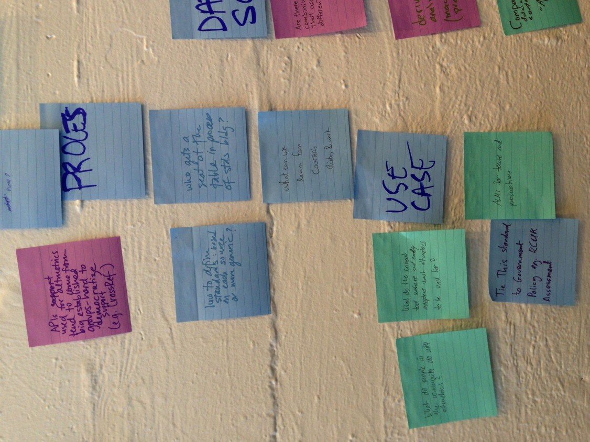
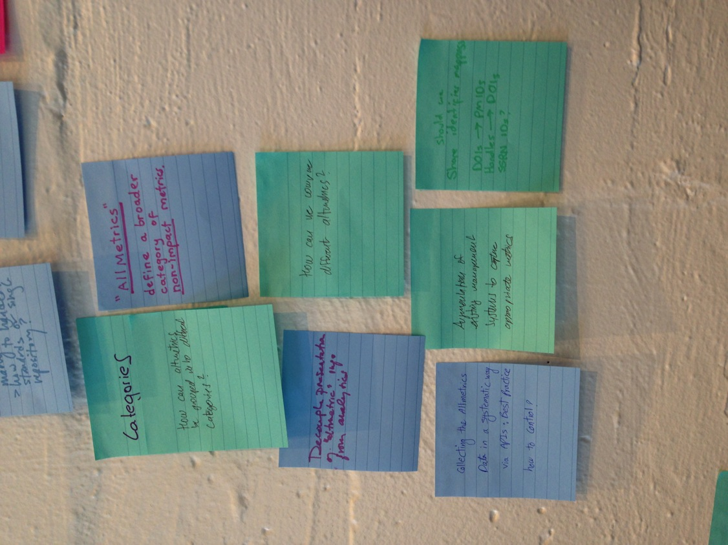

Slide 25
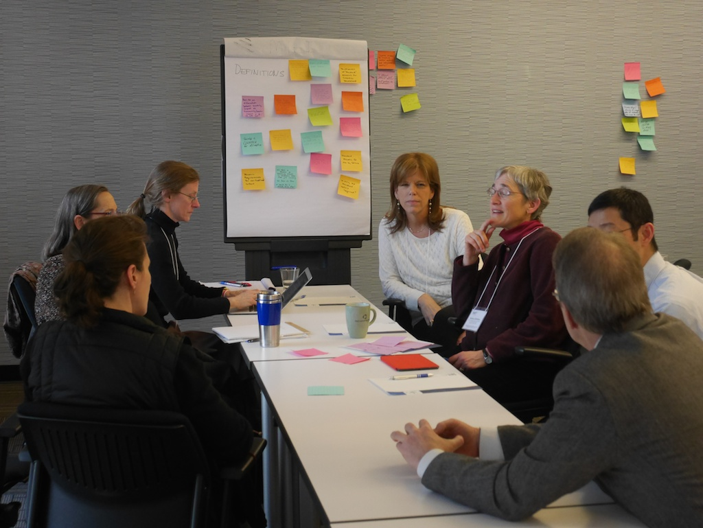
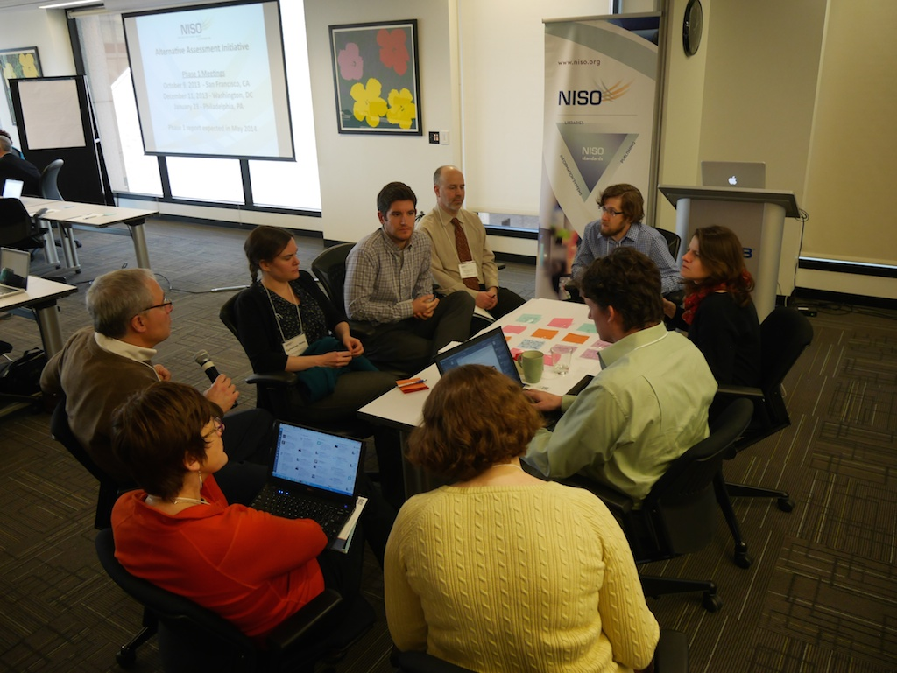
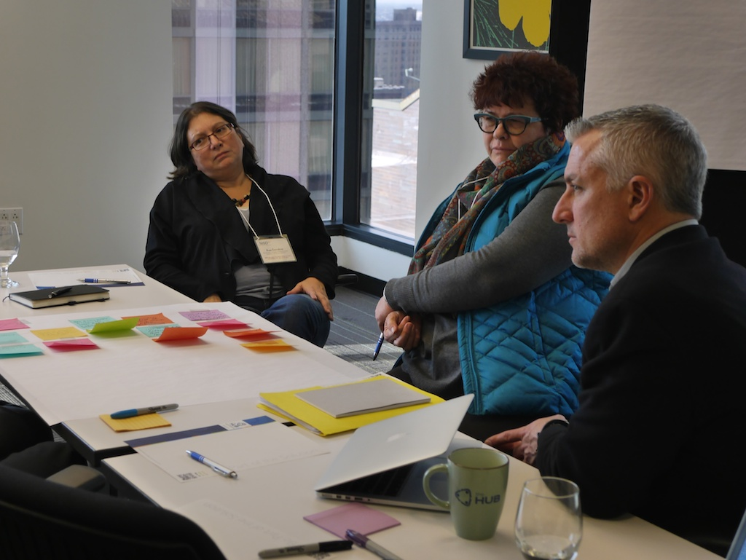

Slide 26
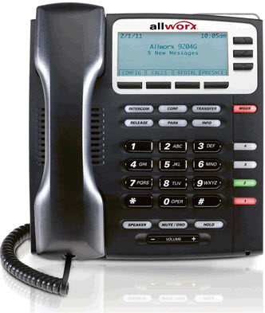
30 One-on-One Interviews

Slide 27
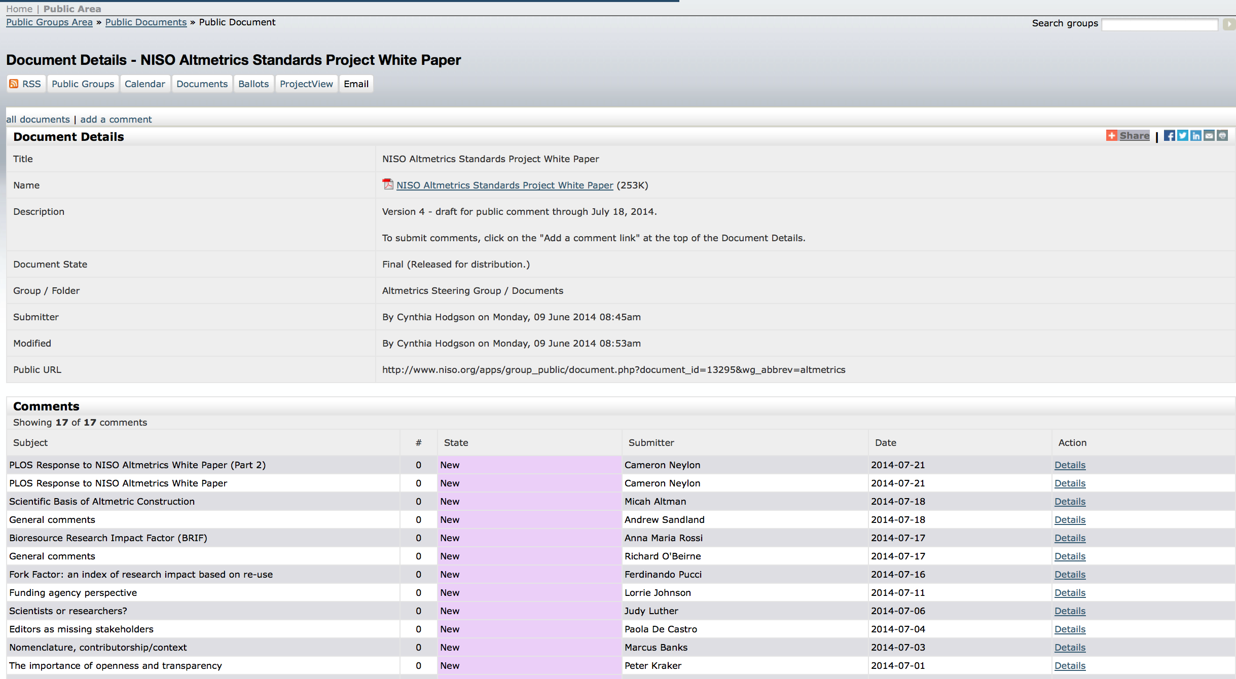
White Paper Released

Slide 28
Potential work themes
Definitions
Application to types of research outputs
Discovery implications
Research evaluation
Data quality and gaming
Grouping, aggregating, and granularity
Context
Adoption

Slide 29
Potential work themes
Definitions
Application to types of research outputs
Discovery implications
Research evaluation
Data quality and gaming
Grouping, aggregating, and granularity
Context
Adoption
Notes:
Specific definition for alternative assessment metrics
Altmetrics
Article-Level Metrics
Research Assessment
Scholarly Impact
Quality of Research
Agree on using the term altmetrics, or on using a different term
Subcategories for alternative assessment metrics, as needed

Slide 30
Potential work themes
Definitions
Application to types of research outputs
Discovery implications
Research evaluation
Data quality and gaming
Grouping, aggregating, and granularity
Context
Adoption
Notes:
Identify research output types that are applicable to the use of metrics.
Define relationships between different research outputs, and develop metrics for this aggregated model.
Define appropriate metrics and calculation methodologies for specific output types, such as software, datasets or performances.

Slide 31
Potential work themes
Definitions
Application to types of research outputs
Discovery implications
Research evaluation
Data quality and gaming
Grouping, aggregating, and granularity
Context
Adoption
Notes:
Agree on main use cases for alternative assessment metrics

Slide 32
Potential work themes
Definitions
Application to types of research outputs
Discovery implications
Research evaluation
Data quality and gaming
Grouping, aggregating, and granularity
Context
Adoption
Notes:
Statement about role of alternative assessment metrics in research evaluation
Identity specific scenarios (e.g. research data, social impact)

Slide 33
Potential work themes
Definitions
Application to types of research outputs
Discovery implications
Research evaluation
Data quality and gaming
Grouping, aggregating, and granularity
Context
Adoption
Notes:
Research into reproducibility
Strategies to improve data quality (Audits)
Strategies to increase trust, e.g. openly available data, audits or clearinghouse
Disconnect between frequent concerns by users and lack of (public) activity by altmetrics providers
Users of altmetrics data (researchers, institutions, funders) should be more proactive in demanding data quality checks and transparency

Slide 34
Potential work themes
Definitions
Application to types of research outputs
Discovery implications
Research evaluation
Data quality and gaming
Grouping, aggregating, and granularity
Context
Adoption
Notes:
Promote and facilitate use of persistent identifiers
Best practices for grouping and aggregating multiple data sources
Best practices for grouping and aggregation by journal, author, institution and funder
Contributorship roles
Common practice for a single research output, e.g. for multiple versions, multiple locations, or grouping of all metrics into a single score
Common practice for multiple research outputs, e.g. by journal, by author, or by institution
Challenge of uniquely identifying authors, institutions and funders associated with these research outputs
Aggregation remains problematic, more empirical evidence and transparency needed

Slide 35
Potential work themes
Definitions
Application to types of research outputs
Discovery implications
Research evaluation
Data quality and gaming
Grouping, aggregating, and granularity
Context
Adoption
Notes:
Describe the use-cases for each community, domain and explain the significant differences.
For institutions -
Identify best practices for identifying contributor categories (e.g., scholars vs. general public).

Slide 36
Potential work themes
Definitions
Application to types of research outputs
Discovery implications
Research evaluation
Data quality and gaming
Grouping, aggregating, and granularity
Context
Adoption & Promotion

Slide 37
Alternative Assessment Initiative Phase 2 Presentations of Phase 1 report (June 2014) Prioritization Effort (June - Aug, 2014) Project approval (Sept 2014) Working group formation (Oct 2014) Consensus Development (Nov 2014 - Dec 2015) Trial Use Period (Dec 15 - Mar 16) Publication of final recommendations (Jun 16)

Slide 38
Community Feedback on Project Idea Themes
n=118

Slide 39
Community Feedback on Project Idea Themes

Slide 40
Top-ranked ideas (very important & important >70%)
87.9% - 1. Develop specific definitions for alternative assessment metrics.
82.8% - 10. Promote and facilitate use of persistent identifiers in scholarly communications.
80.8% - 12. Develop strategies to improve data quality through normalization of source data across providers.
79.8% - 4. Identify research output types that are applicable to the use of metrics.
78.1% - 6. Define appropriate metrics and calculation methodologies for specific output types, such as software, datasets, or performances.
72.5% - 13. Explore creation of standardized APIs or download or exchange formats to facilitate data gathering.
70.7% - 11. Research issues surrounding the reproducibility of metrics across providers.

Slide 41
Alternative Assessments of our Assessment Initiative White paper downloaded 4,910 in 110 days 21 substantive comments received 120 in-person and virtual participants at the meetings These 3 meetings attracted >400 RSVPs for live stream Goal: generate about 40 ideas, in total, generated more than 250 Project materials downloaded more than 18,000 times More than 450 direct tweets using the #NISOALMI hashtag Survey ranking of output by 118 people Five articles in traditional news publications 15 blog posts about the initiative

Slide 42
For more Project Site: www.niso.org/topics/tl/altmetrics_initiative/ White Paper: http://www.niso.org/apps/group_public/download.php/13295/niso_altmetrics_white_paper_draft_v4.pdf

Slide 43
Questions?
Todd Carpenter
Executive Director
tcarpenter@niso.org
National Information Standards Organization (NISO)
3600 Clipper Mill Road, Suite 302
Baltimore, MD 21211 USA
+1 (301) 654-2512
www.niso.org

